Slide 1
10.2 Arithmetic Sequences and Series

Slide 2
Arithmetic and Geometric Sequences
3 , 6 , 9 ,12 , 15, ...
+ 3
A constant value is being added
An Arithmetic Sequence
+ 3
+ 3
The Common Difference (d)

Slide 3
Arithmetic and Geometric Sequences
3 , 6 ,12 , 24 , 48, ...
A constant value is being multiplied
The Common Ratio (r)
A Geometric Sequence
×2
×2
×2

Slide 4
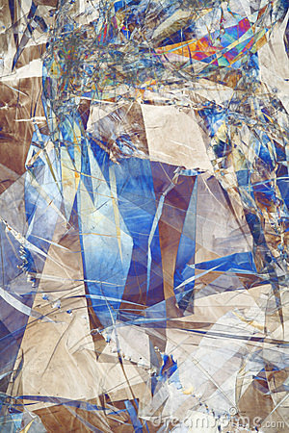
Arithmetic Sequences
3 , 7 , 11 ,15 , 19, ...
a₁ = 3
d = 4

Slide 5
Arithmetic Sequences
3 , 7 , 11 ,15 , 19, ...
a₁ = 3
= 7
= 11

Slide 6
Arithmetic Sequences
3 , 7 , 11 ,15 , 19, ...
a₈=
a₁ +7d
=31
3 +7(4)
a₁₆=
3 +15(4)
a₁ +15d
=63
a_{n} = a₁ + (n –1) d

Slide 7
Arithmetic Sequences
3 , 7 , 11 ,15 , 19, ...
Write an equation for the nth term
a_{n} = a₁ + (n –1) d
a_{n} = -1 + 4n
an = 3 + 4n – 4
a_{n} = 3 + (n – 1) (4)

Slide 8
Arithmetic Sequences
-2 , .... , .... , .... , 18
Find the arithmetic means in the sequence
a₅ = a₁+4d
a₁
a₅
18 = -2+4d
20 = 4d
d = 5

Slide 9
Arithmetic Sequences
-2 , .... , .... , .... , 18
3
8
13
+ 5
+ 5
+ 5

Slide 10
Arithmetic Series
3 , 7 , 11 ,15 , 19, ...
3 +7 +11+15 +19+ ...
The sum of the first n terms is called the partial sum

Slide 11
Arithmetic Series
To find the partial sum
Use
Or

Slide 12
Arithmetic Series
Sigma Notation
Last value of k
nth term
First value of k

Slide 13
Arithmetic Series

