Slide 1
Geometric Sequences and series

Slide 2
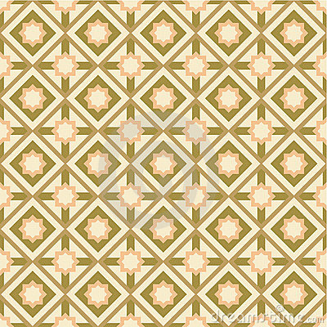
Geometric Sequences
2 , 8 , 32 , 128 , ...
× 4
× 4
× 4
A constant value is being multiplied
The Common Ratio (r)
A Geometric Sequence

Slide 3
Geometric Sequences
2 , 6 , 18 , 54 , 162 , ...
a₁= 2
r = 3

Slide 4
Geometric Sequences
2 , 6 , 18 , 54 , 162 , ...
a₂ = 2 . 3
a₂ = a₁ . r
a₁ = 2
= 6
a₃ = a₂ . r
a₃ = a₁ . r ²
a₃ = 6 . 3
= 18
= a₁ . r ³
a₄

Slide 5
Geometric Sequences
2 , 6 , 18 , 54 , 162 , ...
a₅=
a₁ .r⁴
2 . (3) ⁴
=162
a₁₀=
a₁ . r ⁹
2 .(3)⁹
=39366
a_{n} = a₁ . (r) ^{n – 1}

Slide 6
Geometric Sequences
2 , 6 , 18 , 54 , 162 , ...
Write an equation for the nth term
a_{n} = a₁ . (r) ^{n – 1}
a_{n} = 2 . (3) ^{n – 1}

Slide 7
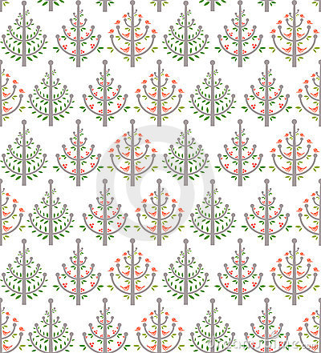
Geometric Sequences
4 , .... , .... , .... , 324
Find the geometric means in the sequence
a₅ = a₁. r ⁴
a₁
a₅
324 = 4 r ⁴
r ⁴ = 81
r = ±3

Slide 8
Geometric Sequences
12
36
108
4 , .... , .... , .... , 324
Or
× 3
× 3
× 3
4 , .... , .... , .... , 324
-12
36
-108
× -3
× -3
× -3

Slide 9
Geometric Series
To find the partial sum
Use
Or

