Slide 1
Infinite Geometric Series

Slide 2
Infinite Geometric Series
1 + 0.5 + 0.25 + 0.125 +0.0625 + ...
S₄ =
S₅ =
S₉ =

Slide 3
Infinite Geometric Series
1 + 0.5 + 0.25 + 0.125 +0.0625 + ...
An infinite geometric series has an infinite number of terms
S₁₇ =
S₂₈ =
A series that has a sum is a convergent series

Slide 4
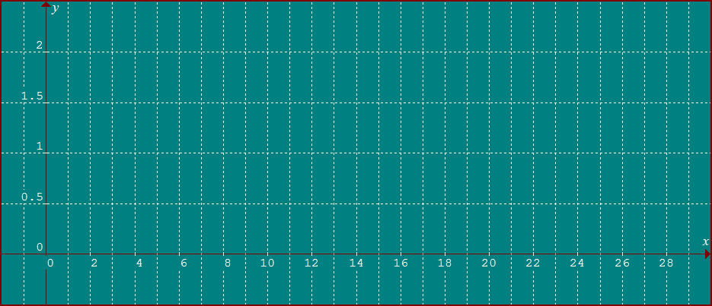
Infinite Geometric Series
Convergent series
| r | < 1

Slide 5
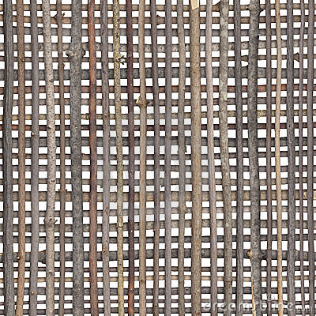
Infinite Geometric Series
1 + 2 + 4 + 8 + 16 + ...
S₅ =
31
S₉ =
511
S₁₅ =
32767

Slide 6
Infinite Geometric Series
1 + 2 + 4 + 8 + 16 + ...
A series that does not have a sum is a divergent series

Slide 7
Infinite Geometric Series
Divergent series
| r | ≥ 1

Slide 8
Infinite Geometric Series
Sum of an Infinite Geometric Series
When | r | < 1
(r ^{n})will approach 0

Slide 9
Infinite Geometric Series
Sum of an Infinite Geometric Series
When | r | ≥ 1
The Series has no Sum

Slide 10
Infinite Geometric Series
If a Series goes to infinity
The infinity symbol ∞ is placed above the Σ

Slide 11
Infinite Geometric Series
a₁
r

Slide 12
Infinite Geometric Series
Write a Repeating Decimal as Fraction
Write as a fraction

Slide 13
Infinite Geometric Series

Slide 14
Infinite Geometric Series

