Slide 1
Graphing Trigonometric Functions

Slide 2
The Sine Function
Angle | Sine
0 | 0
90 | 1
180 | 0
270 | -1
360 | 0
Angle | Sine
0
90
180
270
360
90
180
270
360

Slide 3
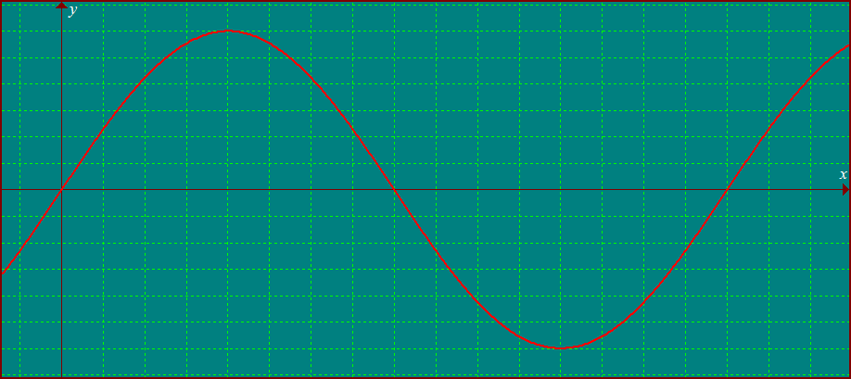
Angle | Sine | Angle | Sine
0 | 0 | 180 | 0
30 | 0.5 | 210 | – 0.5
45 | 0.707 | 225 | – 0.707
60 | 0.866 | 240 | – 0.866
90 | 1 | 270 | –1
120 | 0.866 | 300 | – 0.866
135 | 0.707 | 315 | – 0.707
150 | 0.5 | 330 | – 0.5
y = sin x
90
180
270
360
90
180
270
360

Slide 4
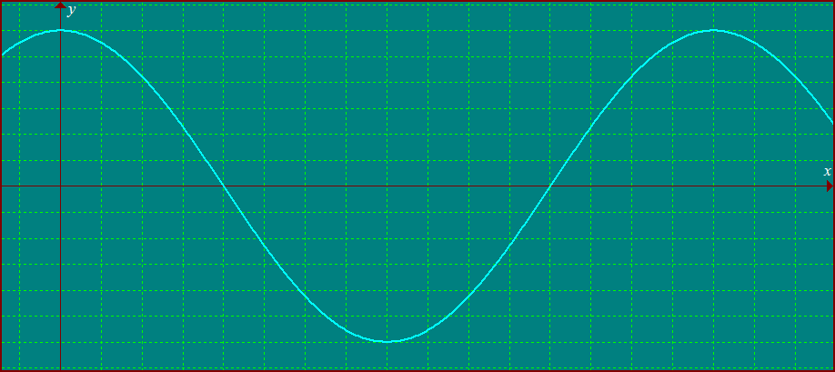
Angle | Cosine | Angle | Cosine
0 | 1 | 180 | –1
30 | 0.866 | 210 | – 0.866
45 | 0.707 | 225 | – 0.707
60 | 0.5 | 240 | – 0.5
90 | 0 | 270 | –1
120 | – 0.5 | 300 | 0.5
135 | – 0.707 | 315 | 0.707
150 | – 0.866 | 330 | 0.866
The Cosine Function
y = cos x
90
90
180
180
270
360
270
360

Slide 5
1
y = sin x
90
180
270
360
-1
{y| -1 y 1}
Domain
{all real numbers}
Range
Amplitude
Period
1
360°

Slide 6
1
y = cos x
90
180
270
360
-1
{y| -1 y 1}
Domain
{all real numbers}
Range
Amplitude
Period
1
360°

Slide 7
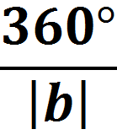
For the graph of
Amplitude =
Period =

Slide 8
To Graph a Trigonometric function don’t make a table
Just depend on its parent function and the transformations, so far; amplitude and period

Slide 9
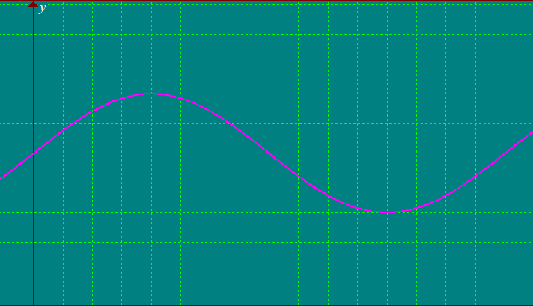
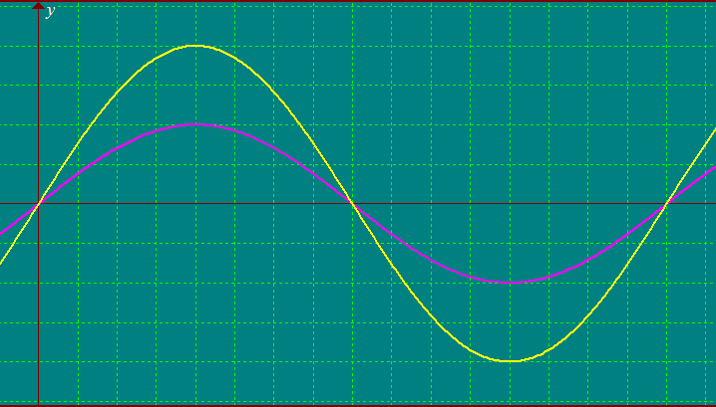
Amplitude = 2
y = 2sin x
2
y = sin x
1
1
y = sin x
90
180
270
360
90
180
270
360
-1
-1
period = 360°
-2

Slide 10
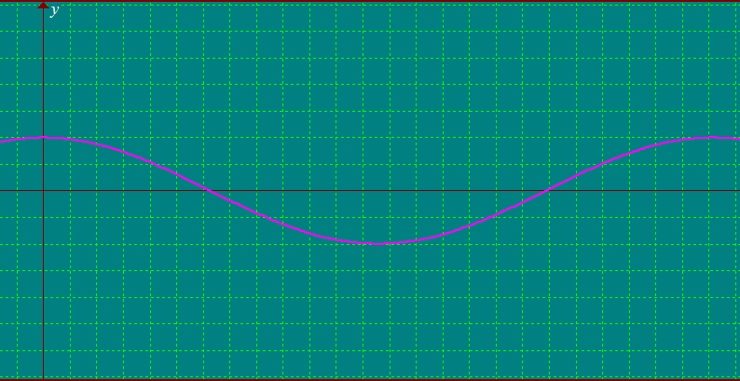
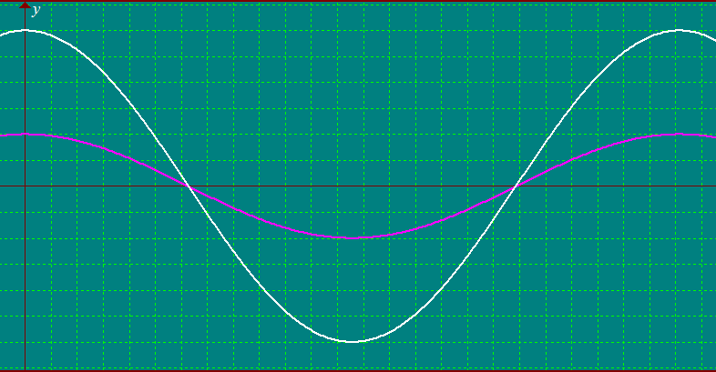
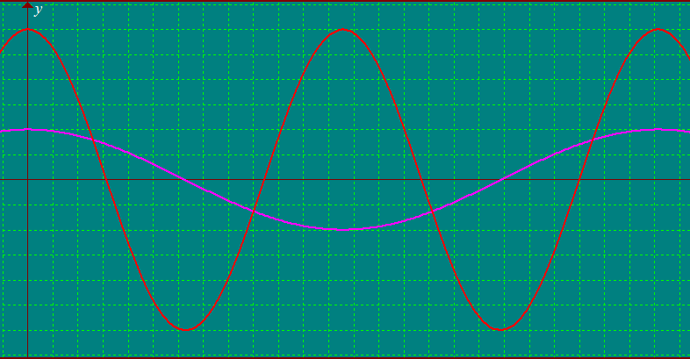
Amplitude = 3
3
3
y = cos x
y = 3 cos x
y = 3cos 2x
1
1
1
90
90
90
180
180
180
270
270
270
360
360
360
-1
-1
-1
-3
-3
period = 180°

Slide 11
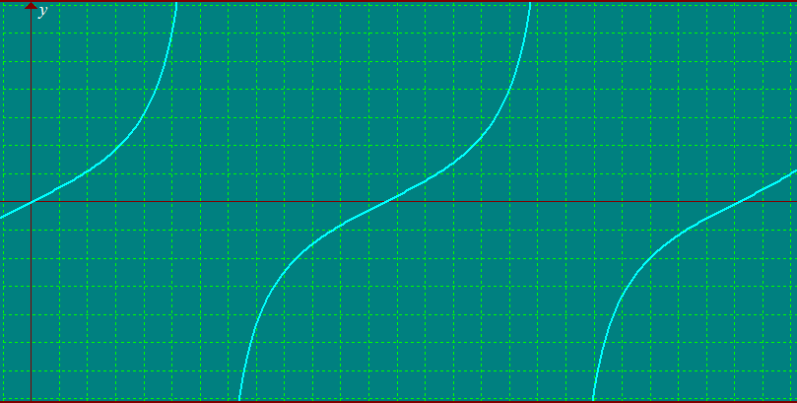
The Tangent Function
Asymptotes
Amplitude undefined
90
180
270
360
period = 180°

