Slide 1
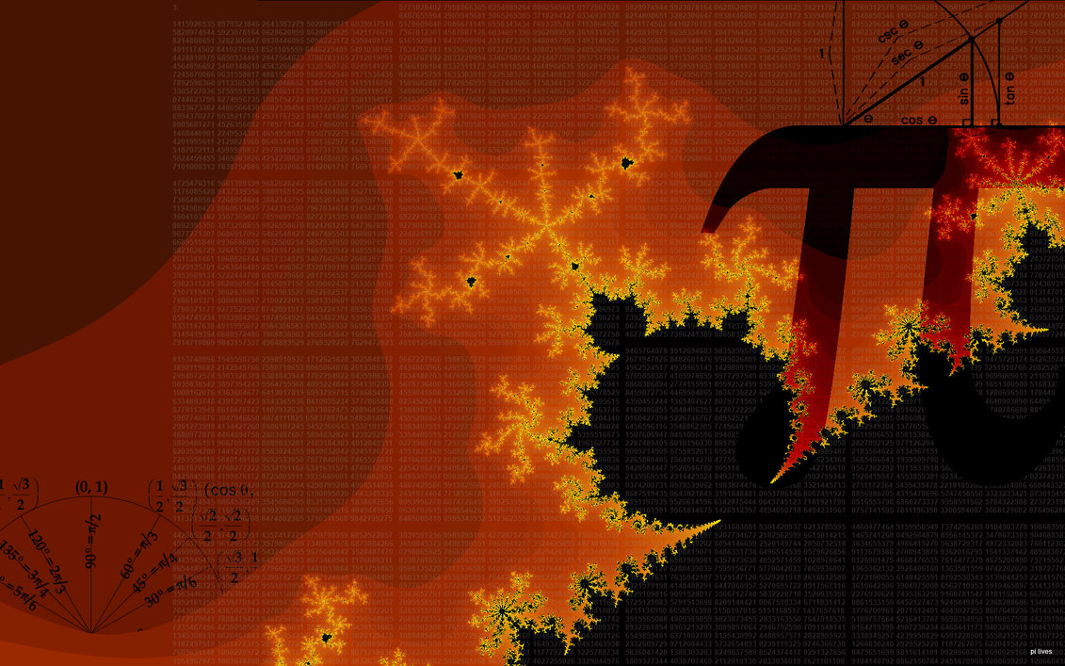
Translations of
Trigonometric
Graphs

Slide 2
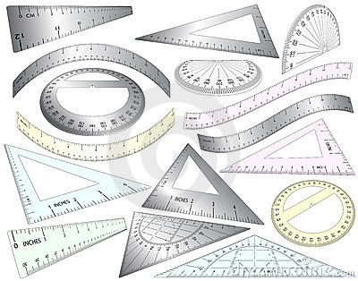
1
Horizontal Translations
Horizontal Translations of a
Periodic Function is called a Phase Shift
Shifting the graph to the right or to the left

Slide 3
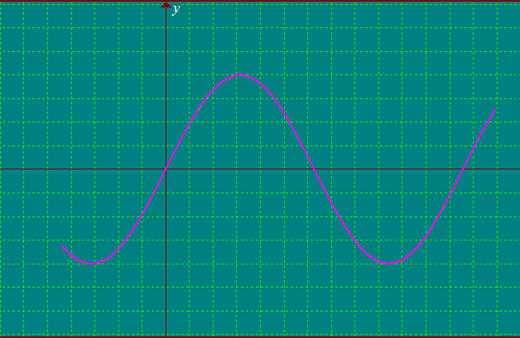
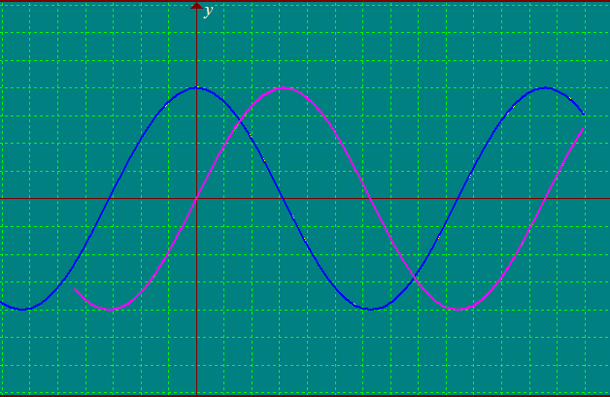
Horizontal Translations
y = sin (θ + 90° )
y = sin θ
y = sin θ
Graph the function of
y = sin (θ + 90° )
1
-180
-90
90
180
270
360
-1
Shifted 90° to the left

Slide 4
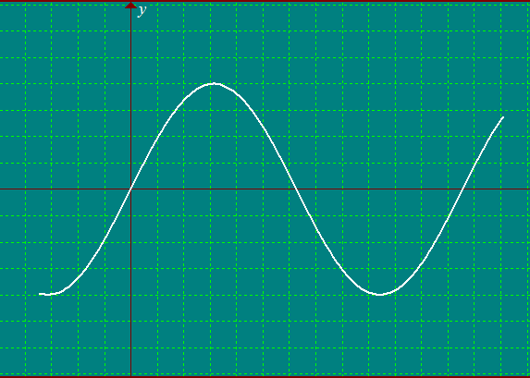
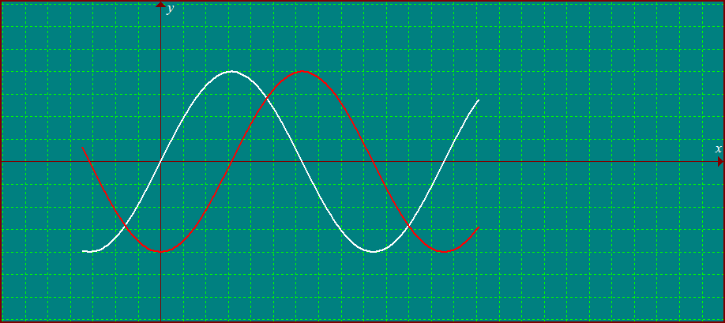
Horizontal Translations
y = sin θ
y = sin (θ – 90° )
Graph the function of
y = sin (θ - 90° )
1
-90
90
180
270
360
-1
Shifted 90° to the right

Slide 5
2
Vertical Translations
Vertical Translations of a
Periodic Function is called a Vertical Shift
Shifting the graph upwards
or downwards

Slide 6
Vertical Translations
y = cosθ +3
4
Graph the function of
y = cos θ +3
y = cos θ
2
1
-90
90
180
270
360
Shifted 3 units upwards
y = cos θ
-1

Slide 7
Concept Summary
Amplitude
Vertical Shift
y = a sin b ( θ – h ) + k
Period
Phase Shift

Slide 8
Guides
1
Determine the vertical shift and graph the midline
2
Determine the amplitude and indicate maximum and minimum values
3
Determine the period and graph the function
4
Determine the phase shift and translate the graph

Slide 9
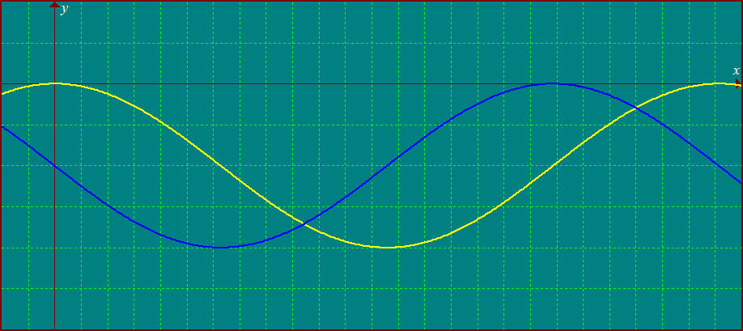
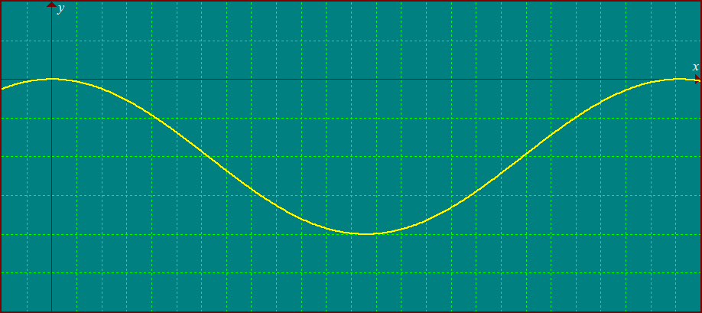
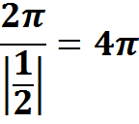
1
2
3
4
Determine the amplitude and indicate maximum and minimum values
Determine the period and graph the function
Determine the phase shift and translate the graph
Determine the vertical shift and graph the midline
State the amplitude, period, phase shift and vertical shift for
Amplitude
= 2
Max = -2 +2 = 0
Mini = -2 – 2 = - 4
vertical shift
= – 2
Midline is
y = – 2
Period =
Phase shift
=
To the left
0
0
π
2π
3π
4π
-4
-4

