Slide 1
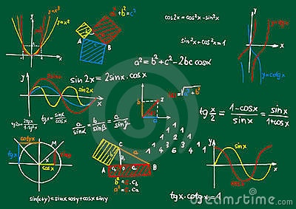
Inverse Trigonometric Functions

Slide 2
A function has an inverse function only if it is a
one-to-one function
Trigonometric functions are not one-to-one functions

Slide 3
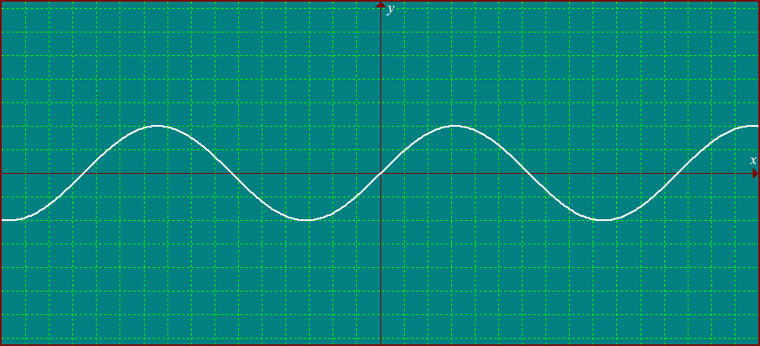
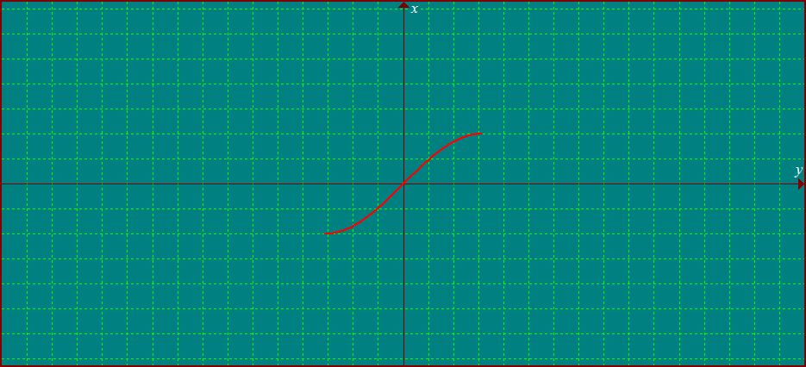
We have to restrict their domains, so the inverse is a function
Inverse of Sine function (Arcsine Function )
Restrict the domain

Slide 4
Domain: ≤ x ≤
Domain:-1 ≤ x ≤ 1
Range: -1≤ y ≤ 1
Range: ≤ y ≤
y = sin x
y = sin ⁻¹ x
1
-1
1
-1

Slide 5
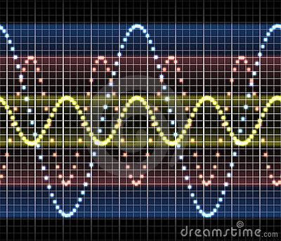
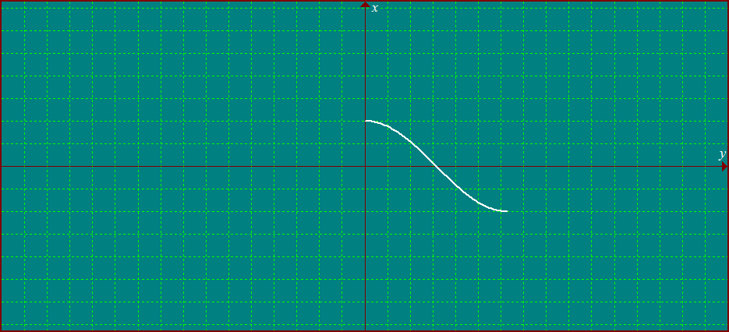
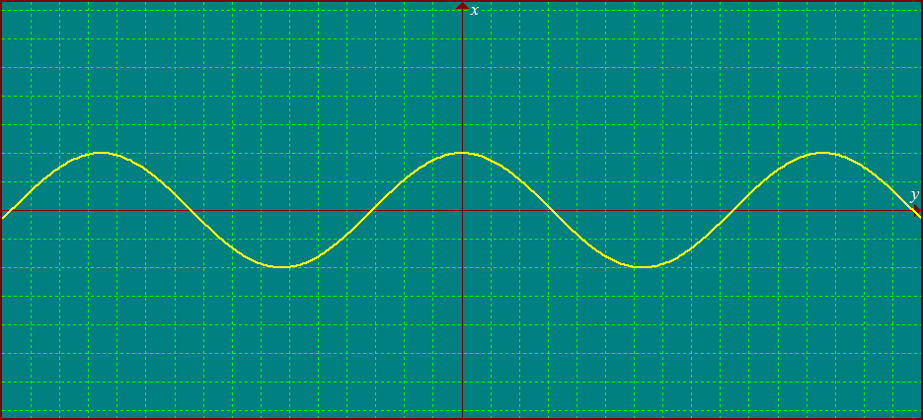
Inverse of Cosine function
(Arccosine Function )
Restrict the domain

Slide 6
Domain: 0 ≤ x ≤
Domain: -1 ≤ x ≤1
Range:-1 ≤ y ≤ 1
Range: 0 ≤ y ≤
y = cos x
y = cos ⁻¹ x
1
0
-1
0
1
-1

Slide 7
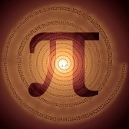
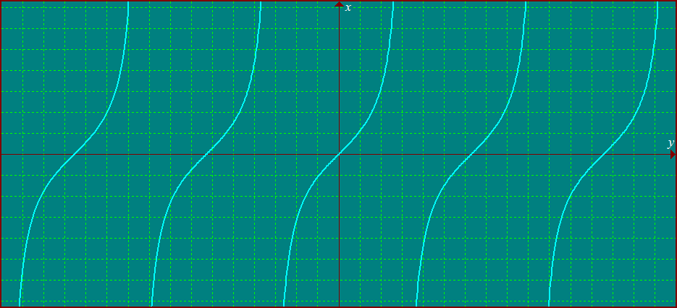
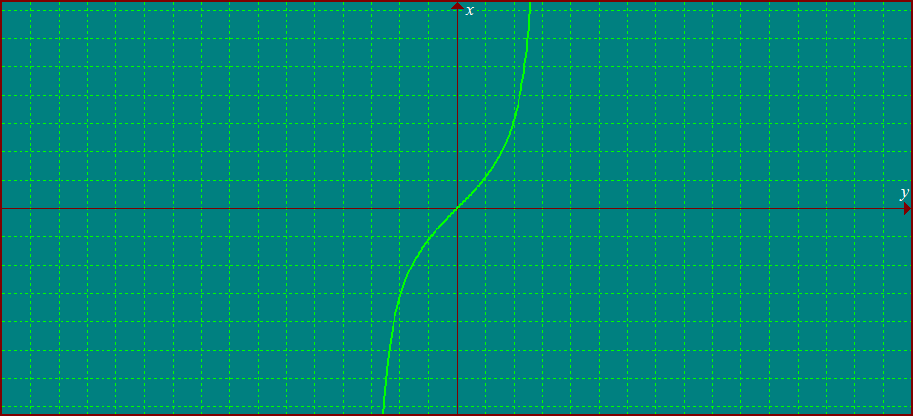
Inverse of Tangent function
(Arctangent Function )
Restrict the domain

Slide 8
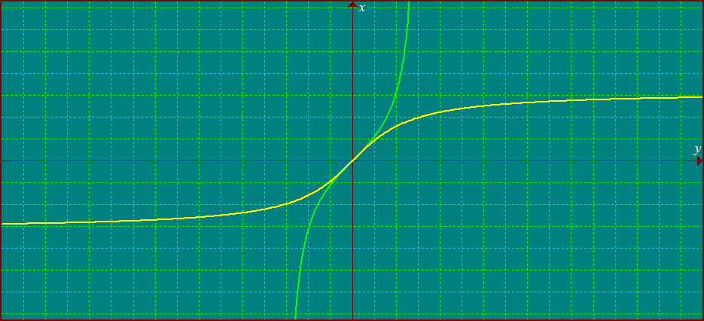
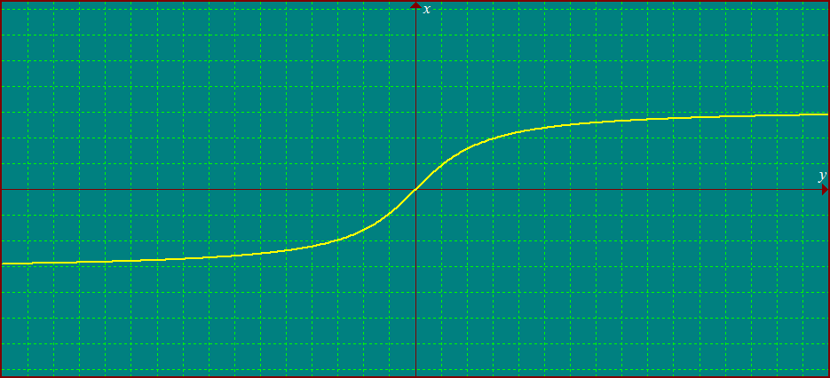
Domain: < x <
Domain : all real numbers
Range: all real numbers
Range: < y <
y = tan ⁻¹ x
y = tan x

